Slide 1
The Closure Principle Revisited
Dror Rom
Prosoft Clinical
IMPACT Symposium
November 20, 2014
Contributions by Chen Chen

Slide 2
This presentation revisits the Closure Principle of Marcus, Peritz, and Gabriel (1976) and its implementation by most multiple testing procedures, which I will show to be sometimes conservative.
Discuss a simple example of a test procedure that follows the original as well as a typical conservative implementation.
Present a generalization of Hochberg’s step-up procedure that is implemented using the original principle with some power comparisons
Utilize Simes’ global test to devise a closed testing procedure that may be powerful than some other Simes’ based procedures
Concluding remarks.

Slide 3
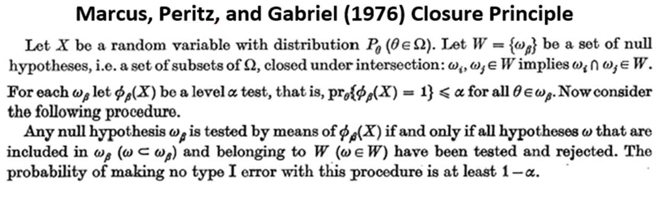

Slide 4
Hochberg and Tamhane (1987)

Slide 6
${H_{1}:μ}_{1}=0 ,$ ${H_{2}:μ}_{2}=0$, against two-sided alternatives
$H_{0}=H_{1}∩H_{2}$
Closed family: $H_{0},H_{1}{,H}_{2}$
Implication relationships: $H_{0}$
$H_{1}$ $H_{2}$

Slide 7
$Z_{1} \sim N\left(0,1\right)$ under $H_{1}$ with a p-value $P_{1}$
$Z_{2}\sim N\left(0,1\right)$ under${ H}_{2}$ with a p-value $P_{2}$
Independent
$φ\left(Z_{1},Z_{2}\right)$ is an $α$ level test for $H_{0}$

Slide 8
A test for the global null hypothesis, $H_{0}$:
For $α=0.05:$ Reject $H_{0}$ if $Z_{1}^{2}+Z_{2}^{2}≥χ_{2, 1−α}^{2}=5.99$

Slide 9
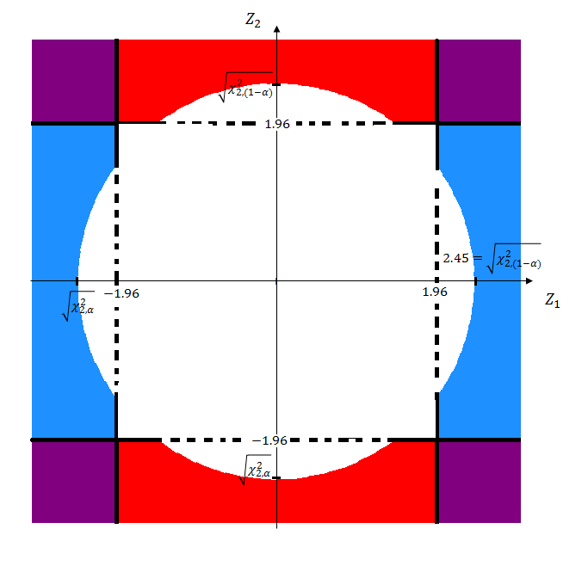
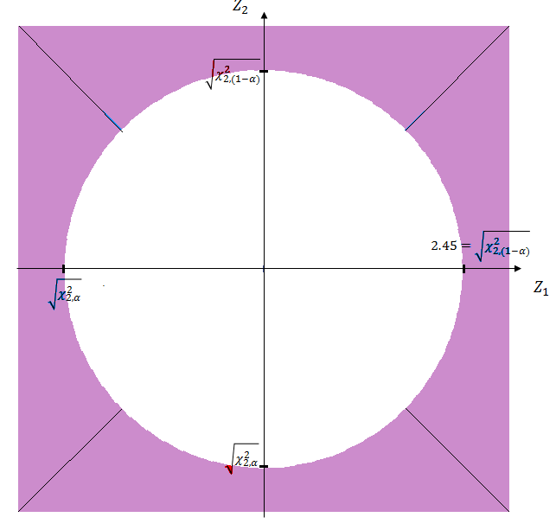
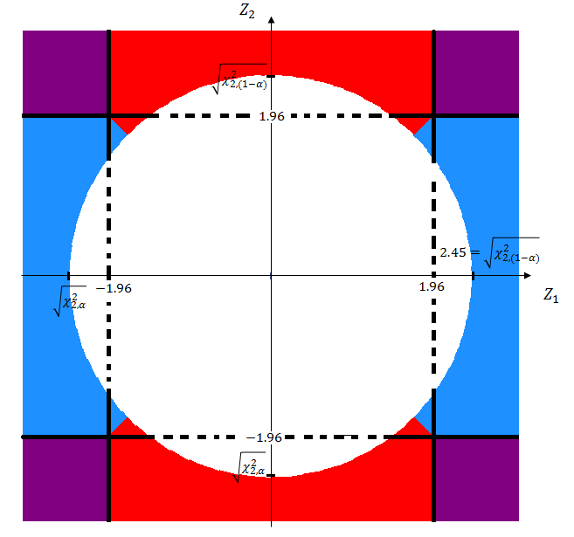
We typically follow the rejection of the global null hypothesis, by a test for $H_{i}:$ Reject $H_{i}$ if $\left|Z_{i}\right|≥z_{1−\frac{α}{2}}=1.96$

Slide 10
Now consider a different procedure:
If the global null hypothesis is rejected, then reject the hypothesis with the smaller p-value

Slide 11
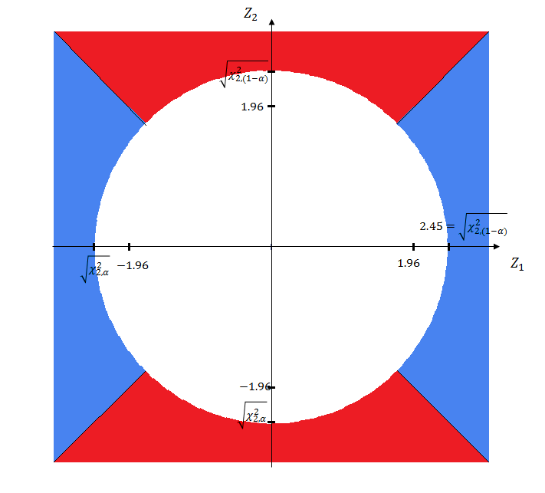

Slide 12
To show that this procedure has strong control of the FWER, we need to show that all hypotheses in the family are protected at level $α$.
Clearly, the global null hypothesis is protected at level $α$ by the Chi-Squared test.
We need to show that each $H_{i}$ is protected at level $α$ whether${ H}_{j}$ is true or not

Slide 13
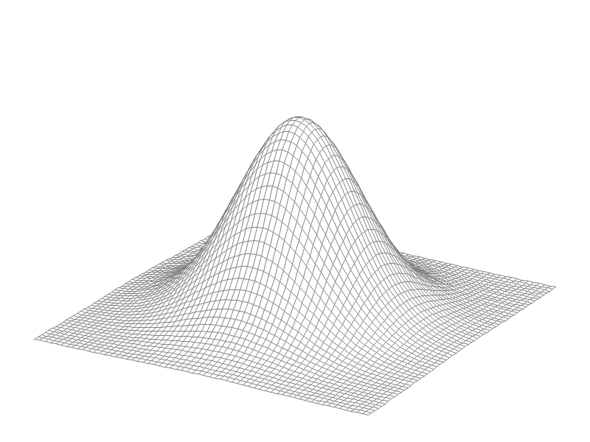
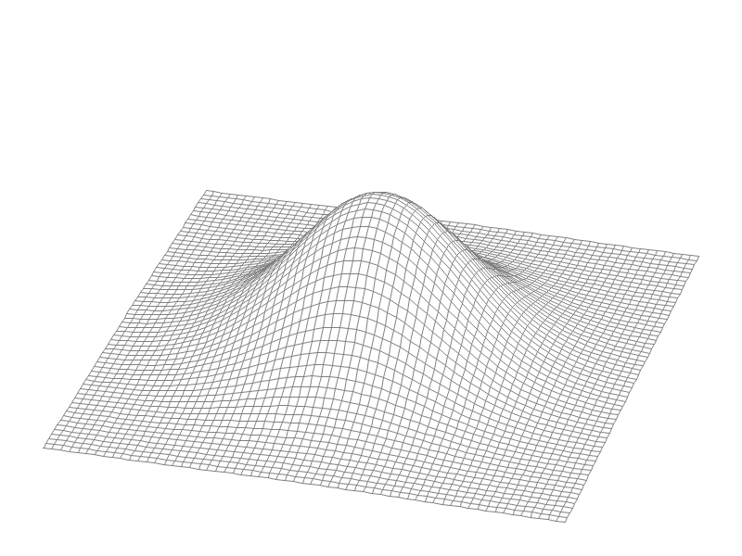
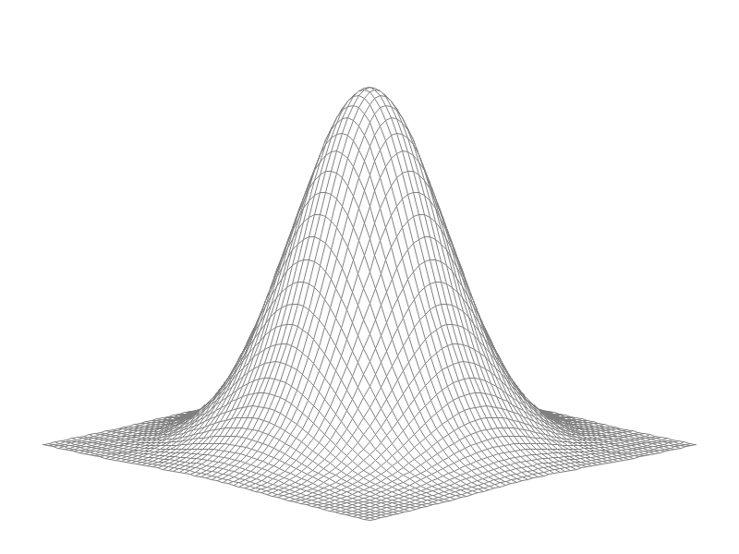
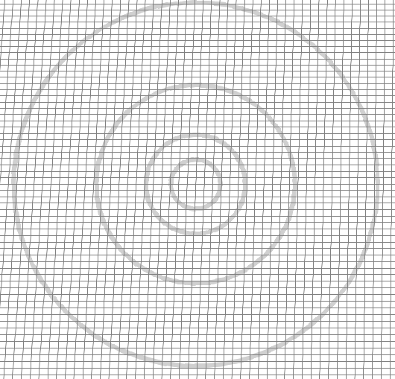

Slide 14
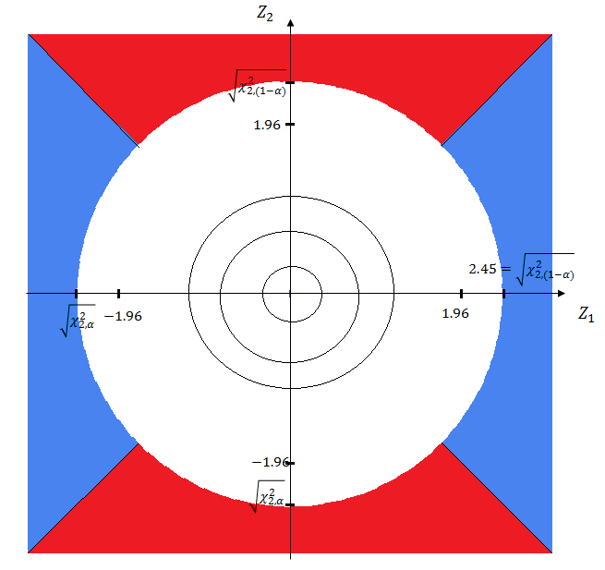

Slide 15
If $H_{2}$ is true, $μ_{2}=0$
$${Pr}_{H_{1}}\left(reject H_{1}\right)=α/2$$

Slide 16
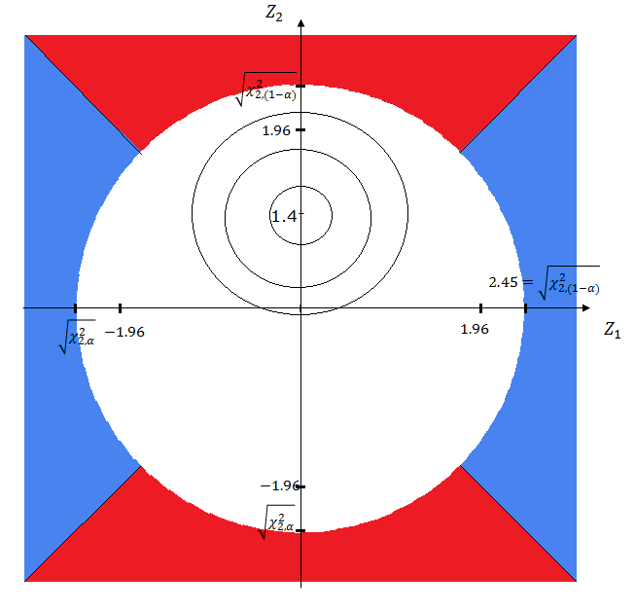
If $H_{2}$ is f$alse, μ_{2}≠0$
Max $\left\{{Pr}_{H_{1}}\left(reject H_{1}\right)\right\}≅0.03$

Slide 17
While some Global tests (example 2-degree of freedom Chi-Squared tests) can be used to make inferences on individual hypotheses, it is not always the case.
For some alphas, type-1 error for individual hypotheses can exceed the nominal level.
In many cases though, type-1 error can be calculated exactly, or bounded as I show next; in most cases, some slight adjustments can be made to control the maximum type-1 error.

Slide 18
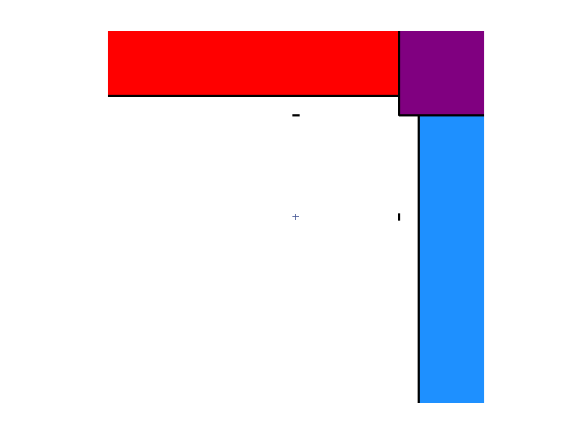
Hochberg’s Procedure
$$Reject H_{2}$$
$$Reject H_{1} and H_{2}$$
$$Z_{2}$$
$$z_{1−\frac{α}{2}}$$
$$z_{1−α}$$
$$Reject H_{1}$$
$$z_{1−α}$$
$$z_{1−\frac{α}{2}}$$
$$Z_{1}$$

Slide 19
$$Reject H_{2}$$
$$Z_{2}$$
$$Reject H_{1} and H_{2}$$
$$z_{1−α′}$$
Consider the following procedure:
Rejects $H_{0}$ if $P_{(1)}≤α^{′}or P_{\left(2\right)}≤α“.$
If $H_{0}$ is rejected, then:
1. Reject $H_{(1)}$, and
2. Reject $H_{i}$ if $P_{i}≤α^{′}$
$$Reject H_{1}$$
$$z_{1−α′′}$$
$$z_{1−α′′}$$
$$z_{1−α′}$$
$$Z_{1}$$

Slide 20
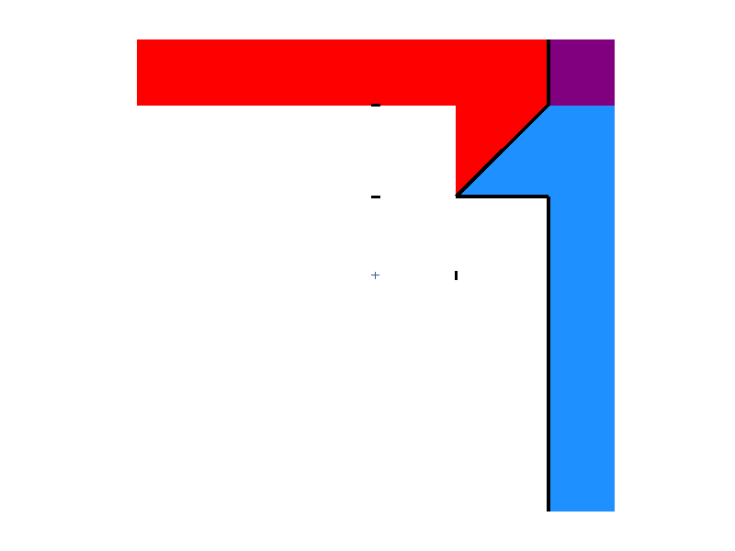
$$Reject H_{2}$$
$$Z_{2}$$
$$Reject H_{1} and H_{2}$$
$$z_{1−α′}$$
$$Reject H_{1}$$
$$z_{1−α′′}$$
$$z_{1−α′′}$$
$$z_{1−α′}$$
$$Z_{1}$$

Slide 21
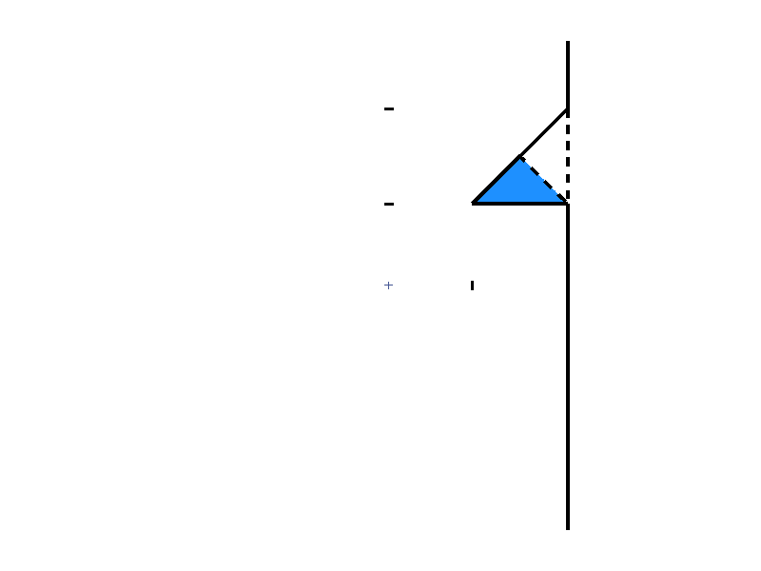
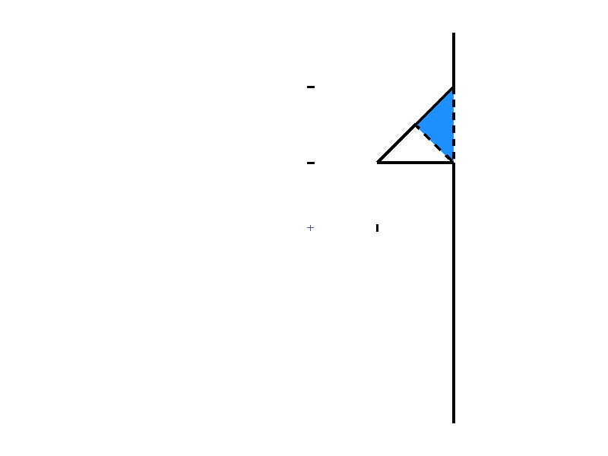
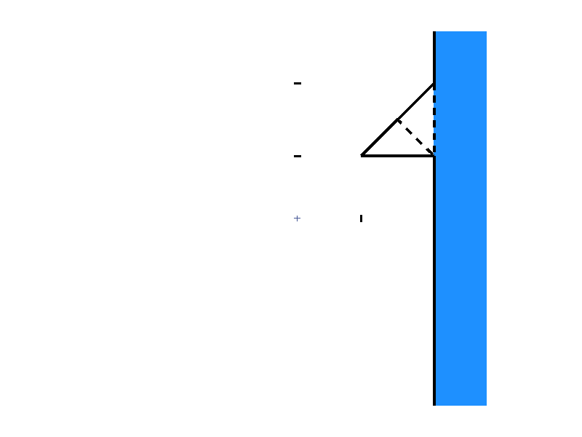
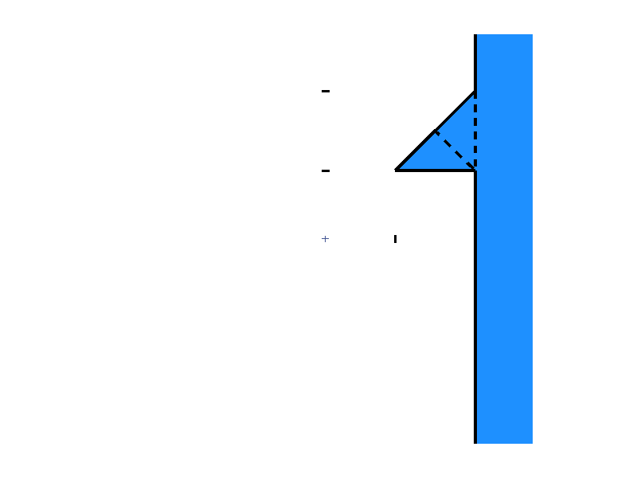
$$Z_{2}$$
$$z_{1−α′}$$
1
2
$$z_{1−α′′}$$
$$z_{1−α′′}$$
$$z_{1−α′}$$
$$Z_{1}$$
$$Max {Prob}_{H_{1}}\left(Reject H_{1}\right)≤$$
$$α′$$
$$+Max 1$$
$$+Max 2$$

Slide 22
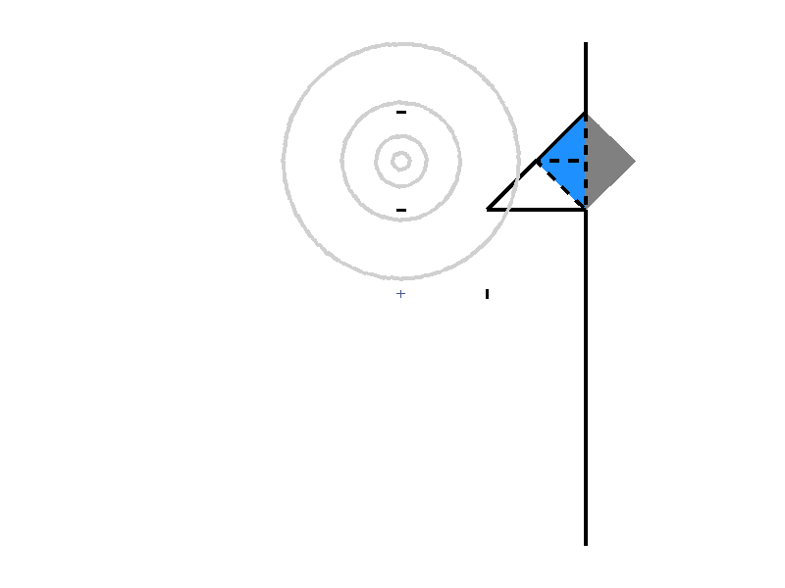
Search for $Max of area 1$
$$Z_{2}$$
$$z_{1−α′}$$
$${z_{1−α′′}+\frac{z_{1−α′}−z_{1−α′′}}{2}}_{}$$
$$z_{1−α′′}$$
$$z_{1−α′′}$$
$$z_{1−α′}$$
$$Z_{1}$$

Slide 23
$$Z_{2}′$$
Search for $Max of area 1$
$$Z_{2}$$
$$z_{1−α′}$$
$${z_{1−α′′}+\frac{z_{1−α′}−z_{1−α′′}}{2}}_{}$$
$$z_{1−α′′}$$
$$Z_{1}′$$
$$z_{1−α′′}$$
$$z_{1−α′}$$
$$Z_{1}$$

Slide 24
$$Z_{2}′$$
Search for $Max of area 1$
$$Z_{2}$$
$$z_{1−α′}$$
$${z_{1−α′′}+\frac{z_{1−α′}−z_{1−α′′}}{2}}_{}$$
$$z_{1−α′′}$$
$$Z_{1}′$$
$$\frac{z_{1−α′′}+z_{1−α′}}{2\sqrt{2}}$$
$$\frac{z_{1−α′′}+z_{1−α′}}{2\sqrt{2}}+\frac{z_{1−α′}−z_{1−α′′}}{\sqrt{2}}$$
$$z_{1−α′′}$$
$$z_{1−α′}$$
$$Z_{1}$$
$$Max 1 ≤{[P_{N\left(0,1\right)}(Z≤\frac{z_{1−α′′}+z_{1−α′}}{2\sqrt{2}}+\frac{z_{1−α′}−z_{1−α′′}}{\sqrt{2}})−P_{N\left(0,1\right)}(Z≤\frac{z_{1−α′′}+z_{1−α′}}{2\sqrt{2}})] }^{2}$$

Slide 25
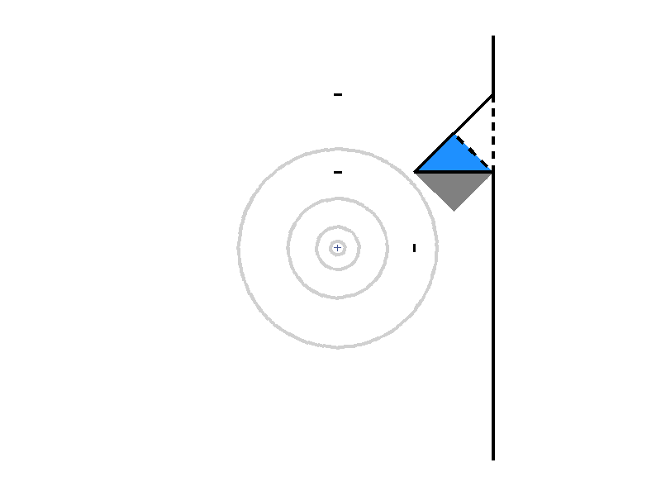
Search for $Max of area$2
$$Z_{2}$$
$$z_{1−α′}$$
$$z_{1−α′′}$$
$$z_{1−α′′}$$
$$z_{1−α′}$$
$$Z_{1}$$

Slide 26
$$Z_{2}′$$
Search for $Max of area$2
$$Z_{2}$$
$$z_{1−α′}$$
$$z_{1−α′′}$$
$$Z_{1}′$$
$$z_{1−α′′}$$
$$z_{1−α′}$$
$$Z_{1}$$

Slide 27
$$Z_{2}′$$
Search for $Max of area$2
$$Z_{2}$$
$$z_{1−α′}$$
$$z_{1−α′′}$$
$$Z_{1}′$$
$$\frac{z_{1−α′′}}{\sqrt{2}}$$
$$\frac{z_{1−α′′}}{\sqrt{2}}+\frac{z_{1−α^{′}}−z_{1−α′′}}{\sqrt{2}} = \frac{z_{1−α′}}{\sqrt{2}}$$
$$z_{1−α′′}$$
$$z_{1−α′}$$
$$Z_{1}$$
$$Max 2 ≤{[P_{N\left(0,1\right)}(Z≤\frac{z_{1−α′}}{\sqrt{2}})−P_{N\left(0,1\right)}(Z≤\frac{z_{1−α′′}}{\sqrt{2}})] }^{2}$$

Slide 28
One-sided $α=0.025$ |  |  | $\text{One}\text{−}\text{sided} α$=0.05
$$α^{′}$$ | $$α^{′′}$$ | Max Type-1 Error for $H_{1}$ | $$α^{′}$$ | $$α^{′′}$$ | Max Type-1 Error for $H_{1}$
0.011 | 0.06687 | 0.023198 | 0.019 | 0.13018 | 0.047819
0.0111 | 0.06517 | 0.022731 | 0.02 | 0.12198 | 0.045267
0.0112 | 0.06341 | 0.022252 | 0.021 | 0.11287 | 0.042552
0.0113 | 0.06158 | 0.021761 | 0.022 | 0.10252 | 0.039618
0.0114 | 0.05967 | 0.021257 | 0.023 | 0.0903 | 0.03637
0.0115 | 0.05768 | 0.020737 | 0.024 | 0.07475 | 0.03261

Slide 29
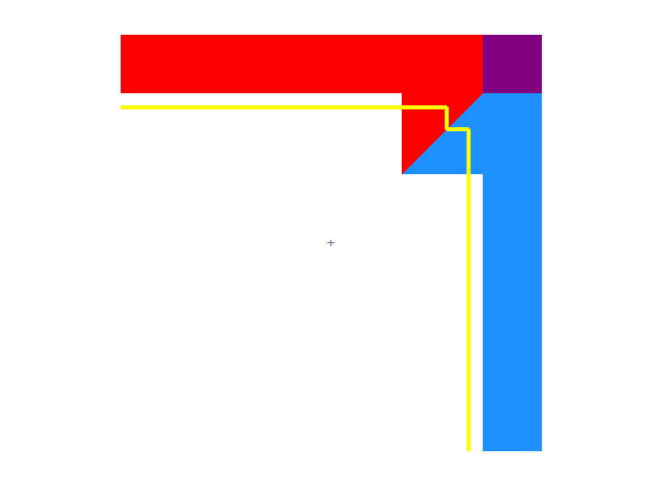
Power of Hochberg and Generalized Hochberg. One-sided $α=0.025$
$$μ_{1}$$ | $$μ_{2}$$ | Hochberg 0.0125, 0.025 | G-Hochberg $α^{′}$=0.011, $α^{′′}$=0.067
0 | 0 | 0.025 | 0.025
0 | 1 | 0.11915 | 0.12012
0 | 2 | 0.41346 | 0.40961
0 | 3 | 0.77969 | 0.77328
1 | 0 | 0.11915 | 0.12012
1 | 1 | 0.20672 | 0.23143
1 | 2 | 0.47529 | 0.51055
1 | 3 | 0.80457 | 0.82077
2 | 0 | 0.41346 | 0.40961
2 | 1 | 0.47529 | 0.51055
2 | 2 | 0.65792 | 0.71627
2 | 3 | 0.87495 | 0.90589
3 | 0 | 0.77969 | 0.77328
3 | 1 | 0.80457 | 0.82077
3 | 2 | 0.87495 | 0.90589
3 | 3 | 0.95541 | 0.97255
$$Z_{2}$$
0.025
$α^{′′}$=0.067
0.0125
$$Z_{1}$$
$α^{′}$=0.011

Slide 30
Simes’ (1986) global test:
Reject $H_{0}$ if $P_{(1)}≤\frac{α}{n},$ or $P_{(2)}≤\frac{2α}{n}$, or …. $P_{(n)}≤$α. Under independence, it is an exact α-level test.
$$To make inferences on individual hypotheses, Hommel \left(1988\right), Hochberg \left(1988\right)$$
$have used Simes^{′}s test$ as a basis for a sequential test.
Notes:
Simes’ is a global test, and is described above. In his paper, Simes had a discussion about making inferences on individual hypotheses following the rejection of the global null. He suggested to use either a Bonferroni or a Holm’s sequentially rejective Bonferroni procedure. He also suggested that perhaps we can tentatively reject the individual hypotheses that are included in the largest set for which his global test satisfies the rejection condition. He recognized though that this suggestion may not have strong control of the FWER

Slide 31
Hommel and Hochberg are conservative procedures, since Simes’ test may reject $H_{0}$ while neither procedure rejects an individual hypothesis.
Three hypotheses, $α=0.05$
Reject $H_{0}$ if $P_{(1)}≤\frac{α}{3},$ or $P_{(2)}≤\frac{2α}{3}$, or $P_{(3)}≤$α
$$P_{(1)}=0.03, P_{(2)}=0.032, P_{(3)}=0.06$$
Simes’ test rejects $H_{0}$at 0.05 level, but neither Hommel nor Hochberg reject any individual hypothesis

Slide 32
Now consider the following procedure:
If Simes’ test rejects $H_{0}$, then:
(1) reject $H_{(1)}$ (the hypothesis with the smallest p-value)
(2) reject any hypothesis with a p-value$≤α/n$
Does this procedure have strong control of the FWER
?
?
For two hypotheses: Yes
Notes:
The case of two hypotheses is shown here. This procedure clearly has strong control of the FWER since it is nested in Hochberg’s procedure

Slide 33
$$H_{0}=H_{1}⋂H_{2}⋂H_{3}$$
$H_{1,2}=H_{1}⋂H_{2}$ ${ H}_{1,3}=H_{1}⋂H_{3}$ ${ H}_{2,3}=H_{2}⋂H_{3}$
$H_{1} H_{2} H_{3}$
Three hypotheses
Reject $H_{0}$ if $P_{(1)}≤\frac{α}{3},$ or $P_{(2)}≤\frac{2α}{3}$, or $P_{(3)}≤$α. If$H_{0}$ is rejected then: (1) reject $H_{(1)}$, and (2) reject any hypothesis with a p-value$≤α/3$
$H_{0}$ is protected at level $α$ by Simes’ test
$H_{i}$’s are protected at level $α$ by the fact that no hypothesis is rejected unless its p-value$≤α$
We need to show that${ H}_{i,j}$’s are protected at level $α$

Slide 34
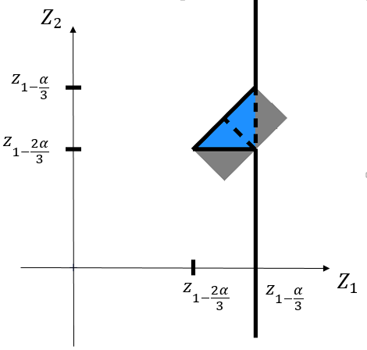
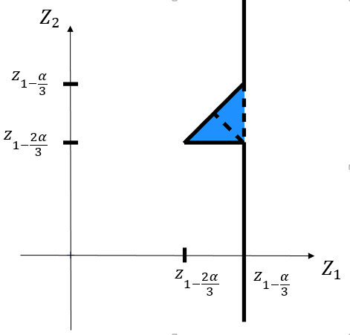
We need to show that $Max {Pr}_{H_{i,j}}\left(reject H_{i,j}\right)≤α$ (whether $H_{k}$ $is true or false$)
Nominal $α$
0.025 | 0.05
1$. { H}_{i,j}$ is rejected if $\left(P_{i}≤\frac{α}{3}\right)∪\left(P_{j}≤\frac{α}{3}\right)$
$≤\frac{2α}{3}$ =
0.0167 | 0.0333
2.1${ H}_{i,j}$ is rejected if $\left({\frac{α}{3}≤P}_{i}≤\frac{2α}{3}\right)$ and $\left({ P}_{k}≤\frac{2α}{3}\right)$ and $P_{i}=P_{\left(1\right)}$
$$≤$$
0.00076 | 0.00169
2.2${ H}_{i,j}$ is rejected if $\left({\frac{α}{3}≤P}_{j}≤\frac{2α}{3}\right)$ and$\left({ P}_{k}≤\frac{2α}{3}\right)$ and $P_{j}=P_{\left(1\right)}$
$$≤$$
0.00076 | 0.00169
2.3 $H_{i,j}$ is rejected if $\left({\frac{α}{3}≤P}_{i}≤\frac{2α}{3}\right)$ and $\left({\frac{α}{3}≤P}_{j}≤\frac{2α}{3}\right)$ and ${(P}_{i}=P_{\left(1\right)} or{ P}_{j}=P_{(1)})$
${≤\left(\frac{α}{3}\right)}^{2}$ =
0.00007 | 0.00028
3. $H_{i,j}$ is rejected if $P_{i}\left(i=1,2,3\right)≤α,$ and ${(P}_{i}=P_{\left(1\right)}or{ P}_{j}=P_{(1)})$
$≤α^{2}$ =
0.000625 | 0.0025
0.0184 | 0.0395

Slide 35
Conclusions/Future Research
Closed testing procedures can be devised using global tests rather than local tests
Examples: F-tests, chi-squared tests, Simes’ test, etc
Need to extend to arbitrary $n$
Need to extend to correlated statistics

Slide 36
References
Hochberg, Y. (1998). A sharper Bonferroni procedure for multiple tests of significance. Biometrika, 75 (4), 800–802.
Hochberg, Y., & Tamhane, A. C. (1987). Multiple Comparison Procedures. New York: Wiley.
Holm, S. (1979). A simple sequentially rejective multiple test procedure. Scandinavian Journal of Statistics, 6, 65-70.
Hommel, G. (1988). A stagewise rejective multiple test Procedure based on a modified Bonferroni test. Biometrika, 75 (2), 383-386.
Jiangtao G., t C. Tamhane, A. C., Xi, D. & Rom, D. (2014). A class of improved hybrid Hochberg–Hommel type step-up multiple test procedures. Biometrika (To Appear).
Marcus, R., Peritz, E.,& Gabriel, K. R. (1976). On closed testing procedures with special reference to ordered analysis of variance. Biometrika, 63 (3), 655-660.
Sarkar, S. K. Generalizing Simes’ Test and Hochberg’s Step UP Procedure. (2008) The Annals of Statistics, 36 no. 1, 337--363.
Sarkar, S. K. Some probability inequalities for ordered MTP random variables: a proof of the Simes conjecture. (1998) The Annals of Statistics, 26 no. 2, 494--504.
Simes, R. J. (1986). improved Bonferroni procedure for multiple tests of significance. Biometrika, 73 (3), 751-754.

